Slide 1


Designing and implementing ralang
Daniel Pacheco
S13165877
Ralang is a programming language for beginners.
Designing and Implementing Ralang

Slide 2
overview
Daniel Pacheco
S13165877
Literature
Technologies & tools
Design and Implementation
Testing & questionnaire results
Development Process
Technical Issues
Further work
RESOURCES
Designing and Implementing Ralang

Slide 3
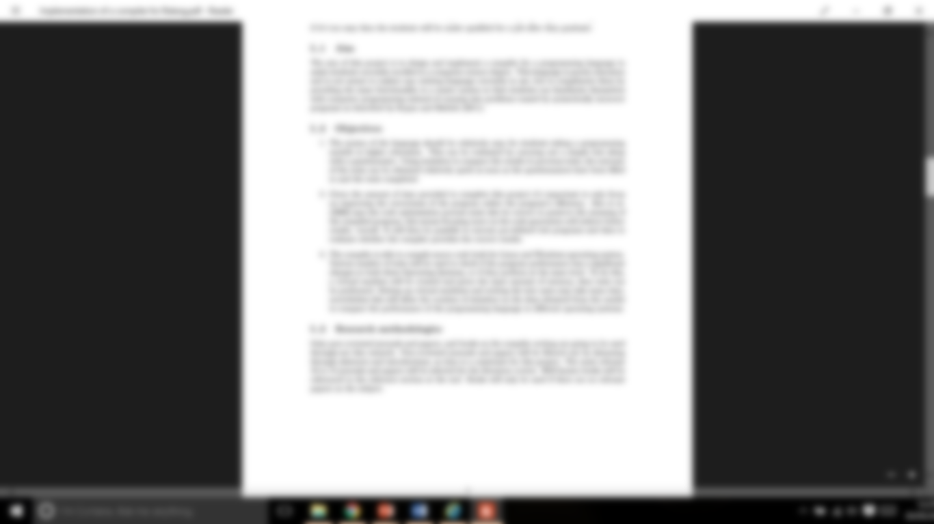

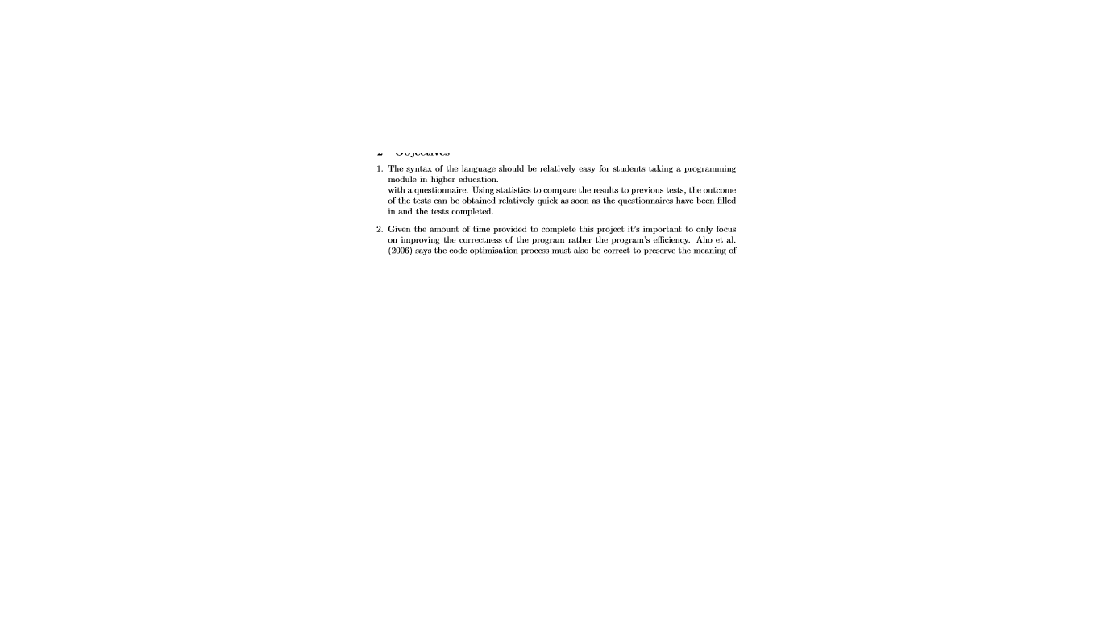
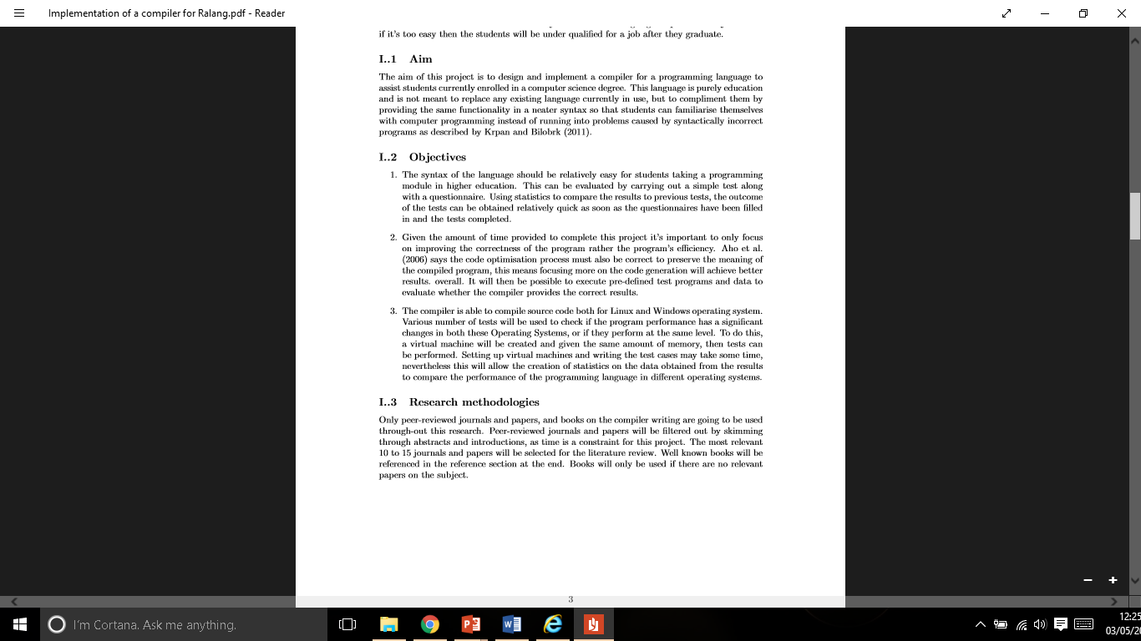
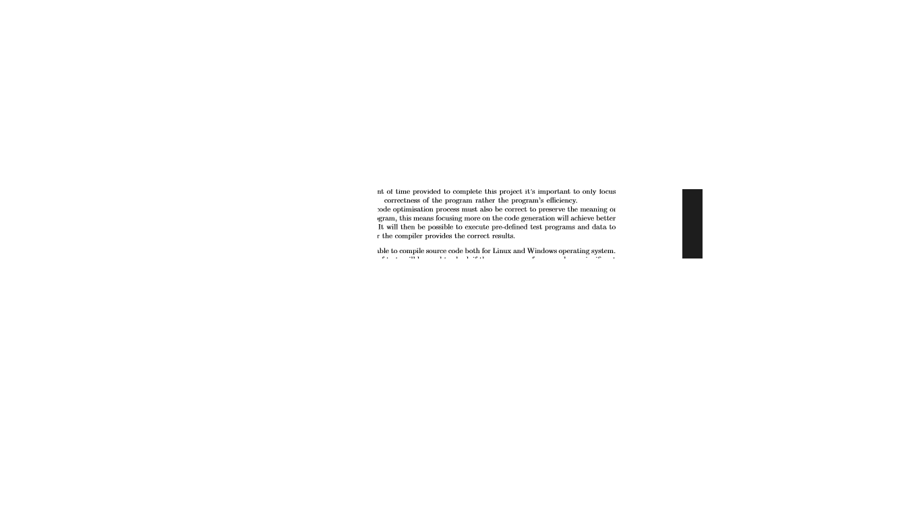

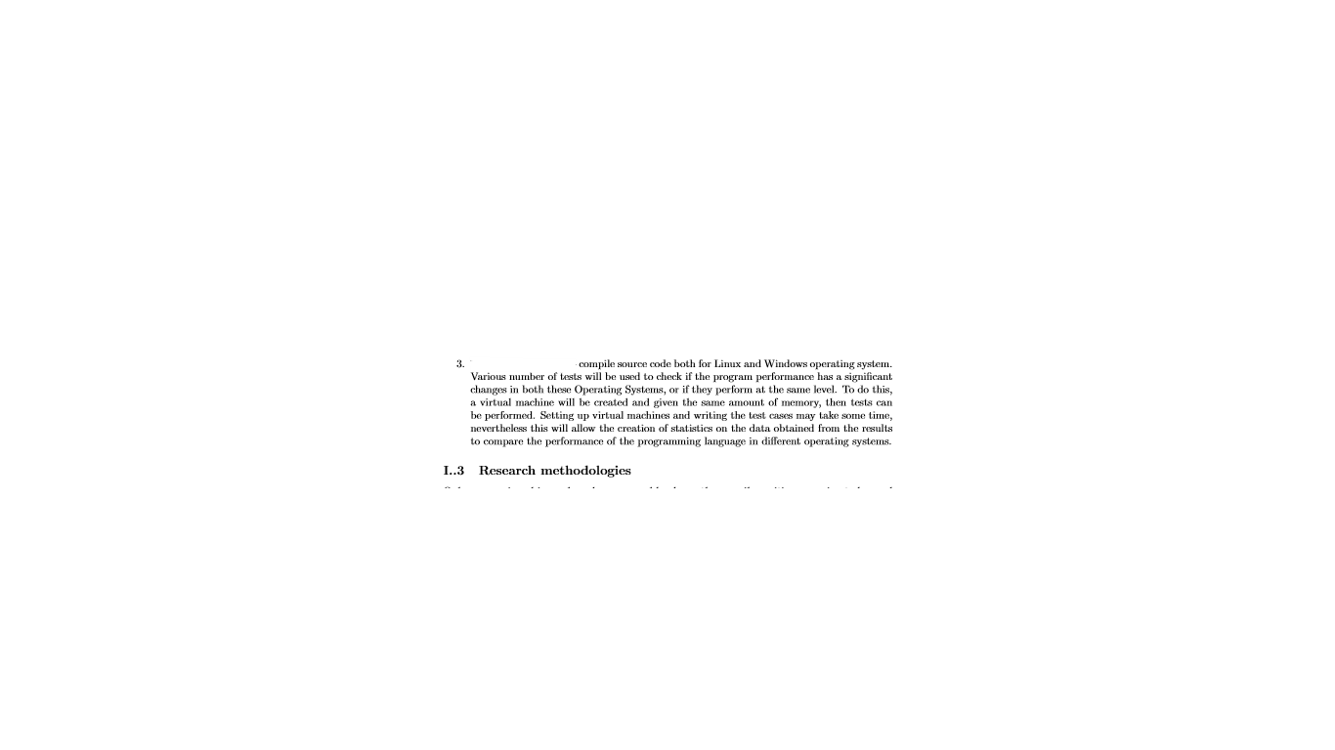
Literature
Daniel Pacheco
S13165877
Designing and Implementing Ralang

Slide 4



Technologies & tools
Daniel Pacheco
S13165877
Designing and Implementing Ralang

Slide 5
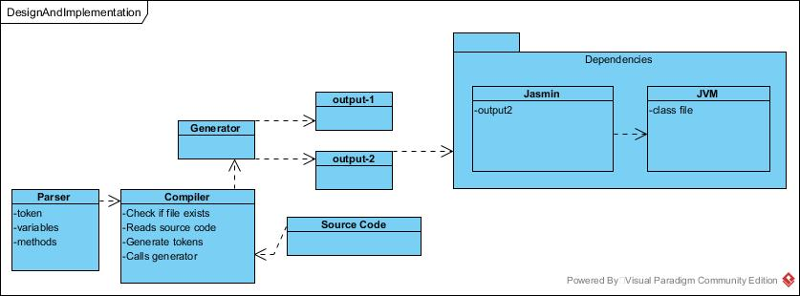
DESIGN AND IMPLEMENTATION
Daniel Pacheco
S13165877
Designing and Implementing Ralang

Slide 6
Tests & QUESTIONNAIRE RESULTS
Daniel Pacheco
S13165877
Black-box testing
17 different tests both on windows and linux
Questionnaire
Half really like ralang’s syntax
12.5% said control flow is not clear
Designing and Implementing Ralang

Slide 7
Development process
Daniel Pacheco
S13165877
Test Case
Study
Develop
Test
Feedback
3 things to Consider:
Yield meaning
Consistency
Interpretation
Designing and Implementing Ralang

Slide 8
Technical issues
Daniel Pacheco
S13165877
Designing process
5 year old laptop
A QUOTE FROM Jasmin's about page:
"Generating a binary Java .class file is pretty fiddly.”
Designing and Implementing Ralang

Slide 9
Further work
Daniel Pacheco
S13165877
Documentation
Unit testing
Code optimisation
User-defined datatypes
Research Study
Designing and Implementing Ralang

Slide 10
RESOURCES
Daniel Pacheco
S13165877
COMPILERS – PRINCIPLES, TOOLS & TECHNIQUES
LET’S BUILD A COMPILER BY JACK CRENSHAW
JAVA VIRTUAL MACHINE ONLINE INSTRUNCTION REFERENCE
JASMIN INSTRUCTIONS AND JASMIN USER GUIDE BY JONATHAN MEYER
CLOJURE OFFICIAL DOCS AND STACK OVERFLOW (MINIMAL)
Designing and Implementing Ralang

Slide 11
Thank you
Daniel Pacheco
S13165877
Designing and Implementing Ralang

